Slide 1



SPONSORSHIP BROCHURE
RACE
BUILD
DESIGN
TEAM
ELECTRO
INFINIFTY

Slide 2

INTRODUCTION
Team Electro Infinity is the Electric Formula student team of Terna engineering college Nerul .
Team Electro Infinity participates in competitions like Formula Bharat and NEKC. These events challenges us to apply our skills outside of the classroom as part of a project that closely imitates industry practices.
Team Electro Infinity was established on 25th September 2019 and participated in NEKC 2020 in February and going to participate in Formula Bharat 2021.
We aim at bringing out concepts of classroom studies and use that concepts to make enginnering marvels in the form of race cars. We are a team of 40 members from various streams to complete one common goal.

Slide 3
Team Composition
TEAM OVERVIEW
Marketing Head – Marketing head handles all the sponsorship work , sales related work and all the work related to marketing with cost report.
Captain
Vice Captain
Technical Head
Marketing Head
Electric Head
Electric Head – Electric head handles four ESO assigned by the team who works on the electrical system included power train system.
Technical Head- Technical head handles all the mechanical departments of the team. Team has four mechanical departments 1. Brakes 2.Suspension 3.Steering 4.chassis .
All the Three Heads at last reports to the Team manager & Captain.

Slide 4
Formula Bharat
Our team is gearing up for FSEV 2021 which will held on Kari Motor speedway Coimbatore.
Formula Bharat is an engineering design competition in which students from colleges and universities all over the country, compete with a life-size Formula-style vehicle in areas of engineering design, overall cost, marketability and dynamic performance. The series replicates the global student Formula series hosted in around 11 countries per year.
The purpose of this competition is to encourage students to gain hands-on practical experience, while applying engineering theories studied in the classroom. In addition, students learn the art of management and teamwork, which are essential skills required in the ‘real-world’. These student teams are required to build a new vehicle from scratch year-after-year and seek sponsorship and donations by their own means to fund the project.

Slide 5
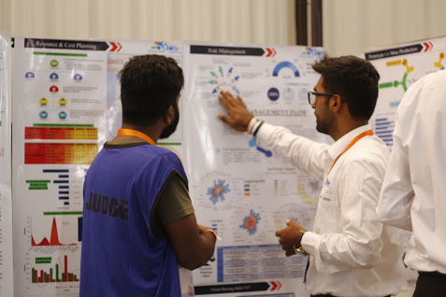
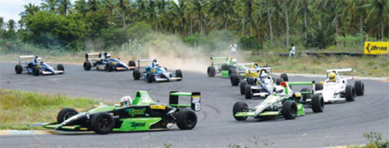
Competition Overview
Static Events
1- Business Plan Presentation.
Dynamic Events
1- Skidpad.
2- Design Report Presentation.
3- Cost Report Presentation.
2- Acceleration.
3- Autocross.
4- Efficiency.
5- Endurance.

Slide 6


What we can do for you…
Being a student motorsports team, we are in constant need of industry partners and sponsors to support us in our operations We look forward towards building a strong association with our partners who help us through funds tools and services In return, we provide our partners with increased brand recognition and networking opportunities with our talented student members.

Slide 7

Branding Avenues
Media coverage – Formula Bharat draws the attention national and International Print and News media .
Media Coverage
Print media – Official news paper of Terna Engineering college Nerul and planning to collaborate with well-known news paper too.
College Events -Special Mention of the sponsor when car is showcased during the following events
Lectures & workshops organized by Team Electro Infinity during academic year.
Launch event of car.
Alumini meets.
Media conferences on automobiles.
Avalon – The national level technical festival .
Antarang – The annual cultural festival.
Sportec – The annual sports festival.
National technology day.
Radio – Tarang (Official radio of Terna Engineering college Nerul ).
Sponsor’s logo – Your company's logo will be present on the Vehicle, T-shirts, Letterheads, Banners displayed at the pit during events.
Online branding- Your company will be promoted through our social media patforms like Instagram, Facebook, Linkdin, Twitter etc reaching out thousands of people.

Slide 8
Sponsorship Benefits
PLATINUM LEVEL [ > 2,00,000 ]
> All Gold level benefits +
> Invitation as a guest of honour for the launch event.
> Seperate hoarding In campus during college festival.
> Listed as a main sponsor at race events.
>Special mention of sponsor in official season recap video.
GOLD LEVEL [ > 1,00,000 ]
> All Silver level benefits +
> Special recognition in team Newsletter.
>Sponsors would be provided With personalized team merchandise and team photo.
SILVER LEVEL [ > 50,000 ]
> All Bronze level benefits+
> Logo featured on Team t-shirts.
>Hoarding on pits during Competitions.
>Publicity in college festival.
BRONZE LEVEL [ < 50,000 ]
>Name featured on Team official website.
>Logo featured on car.
>Partnership certificate.
>Promotion on social media handles.
TAX EXEMPTION BENEFITS - Team Electro Infinity is college team so there will be a Income tax rebate of 12.5% for research purpose(Section 35, Income tax act).
CORPORATE SOCIAL RESPONSIBILTY – The event provides you a platform to showcase support for research at college level and emerge as a promoter for research which adds to CSR of your company.
ACCESS THE MIND OF FUTURE ENGINEER – Your company can see the actual thought process of current students.
BE AN EMPLOYER OF CHOICE – By sponsoring us you are the future employees by helping student gaining practical skills used in Industries.

Slide 9





PARTNERING WITH TEAM ELECTRO INFINTY
WAYS TO SUPPORT US
OUR PREVIOUS SPONSORS
MONETARY SUPPORT allows the team to cover our expenses and sustain our growth.
Providing us PRODUCTS for free or at a discounted price will take us closer to completing our dream to make a world class formula car.
TECHNICAL INSIGHTS from industry experts allows our our team to develop valuable insights to help us build a racecar prepares our team as they enter industry.
MANUFACTURING SUPPORT help us make our designs a reality.

Slide 10
CONTACT DETAILS
A TOKEN OF THANKS
WE HOPE THE ABOVE DETAILS PROVIDEDS A BETTER INSIGHT ABOUT OUR TEAM,
ITS FUNCTIONING AND YOUR ROLE AS APARTNER TO HELP US ACHIEVE THE BEST.
WE ARE EAGERLY LOOKING FORWARD TO BUILD A STRONG RELATIONSHIP BETWEEN
YOU AND TEAM ELECTRO INFINITY .
IF YOU HAVE ANY QUERIES OR SUGGESTIONS WE WOULD BE MORE THAN HAPPY
TO DISCUSS THEM WITH YOU.
YOURS SINCERELY,
TEAM ELECTRO INFINTY
CONTACT DETAILS
+91-8275827230
teamelectroinfinty@gmail.com
https://teamelectroinfinity.wixsite.com/website-1
team_electro_infinity_

